Slide 1

CS 533 INTRO TO DATA SCIENCE
Michael Ekstrand

Slide 2
VECTOR SPACES

Slide 3

Learning Outcomes
Introduce more formally the concept of a vector space
Understand vector space transformations
Photo by Markus Winkler on Unsplash

Slide 4

Vector Spaces
Remember vectors?
$$x=⟨x_{1},x_{2},…,x_{n}⟩$$
$ℝ^{n}$ is a $n$-dimensional vector space.

Slide 5
Vector Operations
Addition (and subtraction)
Scalar multiplication
Inner products (sum of elementwise products)
Distance (inner product of subtraction with itself)

Slide 6

Matrix of Data Points
Consider a sample $X$
Each row is an instance
Instance is a row vector (row of a matrix)
Can do all the vector things

Slide 7
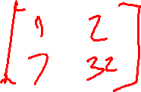
What Is A Matrix?
A collection of row vectors
A collection of column vectors
A linear map from one vector space to another
A few matrix ops:
Addition
Multiplication (by scalar or compatible matrix or vector)
Transpose

Slide 8
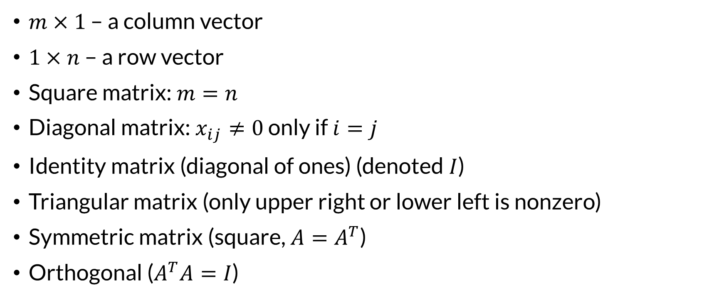
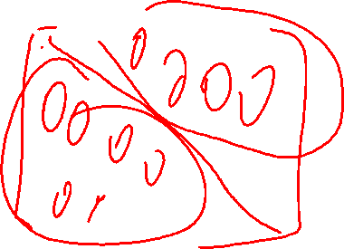
Special Matrices
$m×1$ – a column vector
$1×n$ – a row vector
Square matrix: $m=n$
Diagonal matrix: $x_{ij}≠0$ only if $i=j$
Identity matrix (diagonal of ones) (denoted $I$)
Triangular matrix (only upper right or lower left is nonzero)
Symmetric matrix (square, $A=A^{T}$)
Orthogonal ($A^{T}A=I$)

Slide 9
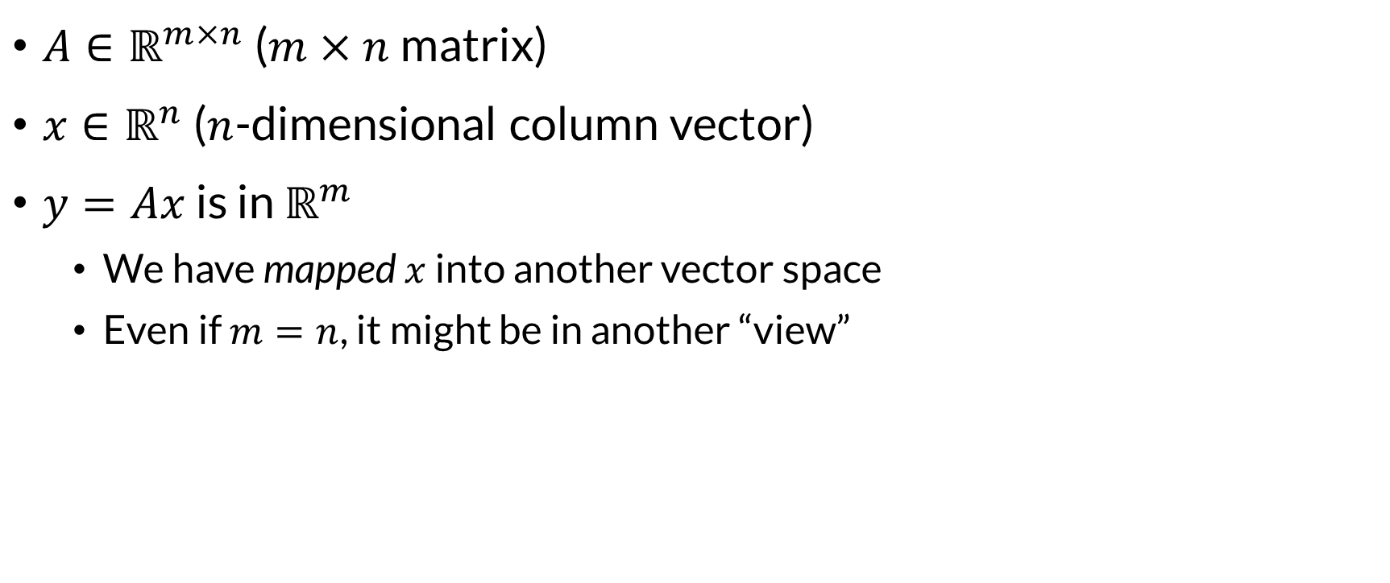
Matrix-Vector Multiplication
$A∈ℝ^{m×n}$ ($m×n$ matrix)
$x∈ℝ^{n}$ ($n$-dimensional column vector)
$y=Ax$ is in $ℝ^{m}$
We have mapped $x$ into another vector space
Even if $m=n$, it might be in another “view”

Slide 10
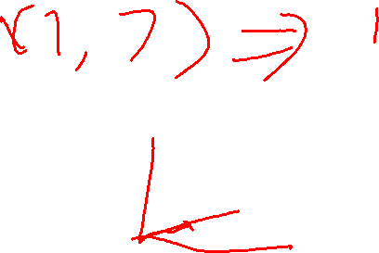
Transformations
All by multiplying by a matrix:
Reduce (or increase) dimensionality
Translate
Scale
Skew
Rotate
Any linear transformation (this is actually what linear means)

Slide 11
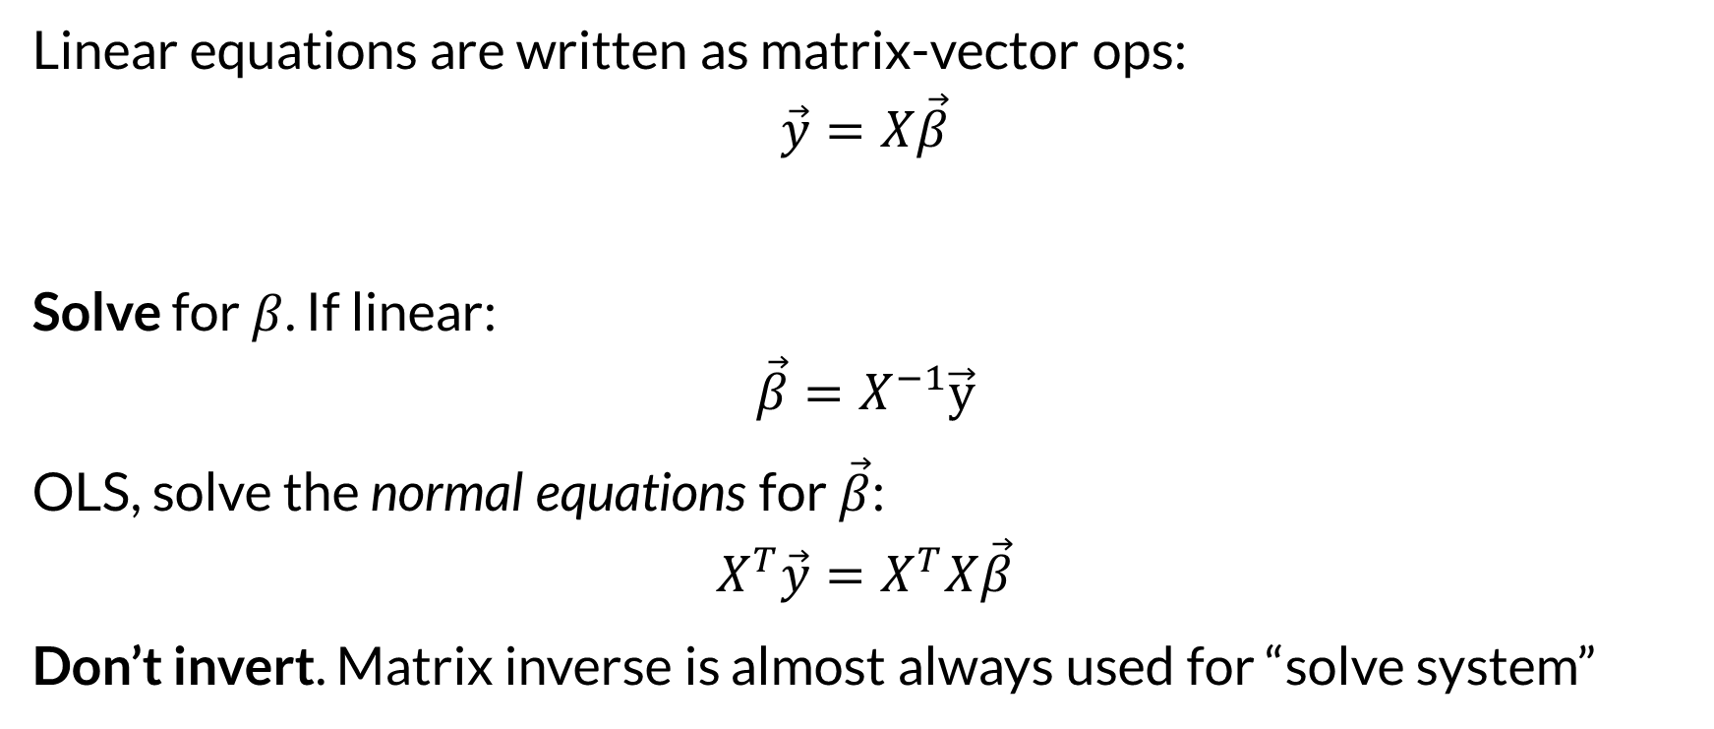
Linear Systems
Linear equations are written as matrix-vector ops:
$$\vec{y}=X\vec{β}$$
Solve for $β$. If linear:
$$\vec{β}=X^{−1}\vec{y}$$
OLS, solve the normal equations for $\vec{β}$:
$$X^{T}\vec{y}=X^{T}X\vec{β}$$
Don’t invert. Matrix inverse is almost always used for “solve system”

Slide 12

Wrapping Up
Vectors represent data points in a vector space.
These can be manipulated and transformed.
Linear algebra teaches much more.
Photo by Jurica Koletić on Unsplash

